Slide 1
Vibe Travel
Multi-Agent Travel Recommender System
PRESENTED BY Catalin Botezat, Srijan Sthapit, Siddhanta Paudel
12/11/2025
https://github.com/VibeTravel/VibeTravel
Notes:
When you travel you try to relax however the whole process is stressful.
Full Stack AI Travel Agency

Slide 2
Executive summary
01
Motivation

Slide 3

Problem statement
Crafting a vacation based on personal interests and budget time constraints without a travel company is stressful

Slide 4

Goal
To create a feed of vacations based on interest and generate a travel plan that suits everyone.

Slide 5
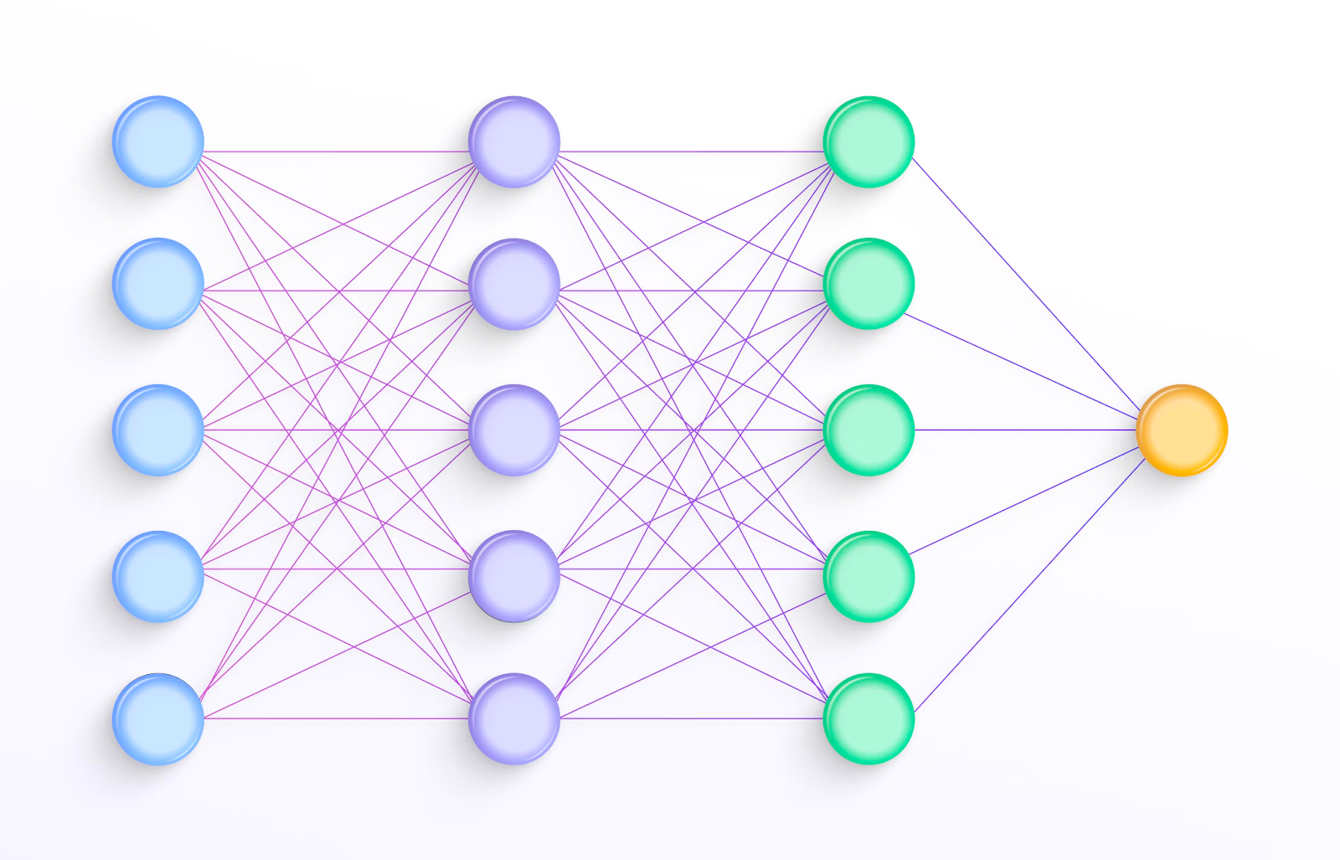
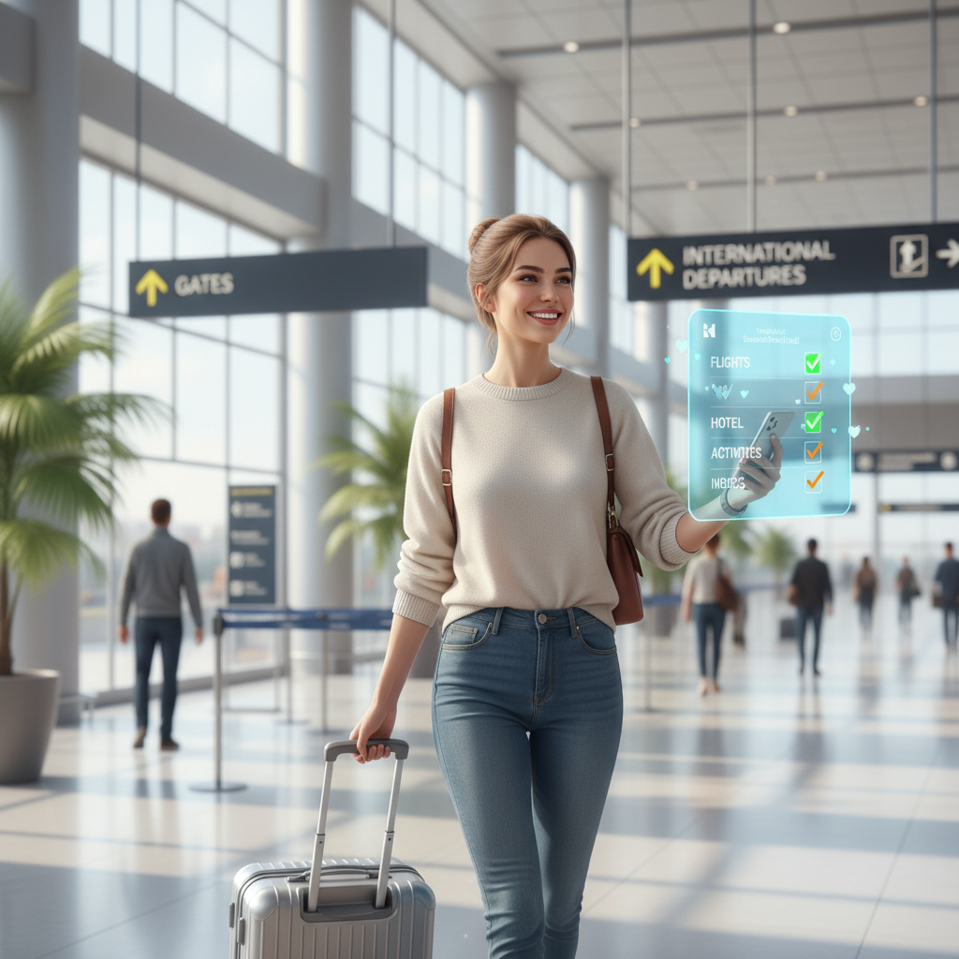


Solution plan
Technical challenges
Complex architecture design.
Reliance on API calls.
Solution approach
Utilising LLM-s in various phases to generate suggestions for the user.
Value/benefit
Hassle free vacation generation.

Slide 6


Motivation and related works
Literature:
TravelAgent: Personalization in travel agents.
Travel planner research paper: Thinking on how to benchmark it.
Personal travel hassle
Struggle in managing finances while travelling
Stressing out over daily activities
TravelPlanner: A Benchmark for Real-World Planning with Language Agents. Jian Xie, Kai Zhang, Jiangjie Chen, Tinghui Zhu, Renze Lou, Yuandong Tian, Yanghua Xiao, Yu Su. arXiv:2402.01622, 2024.arxiv​
TravelAgent: An AI Assistant for Personalized Travel Planning. Aili Chen, Xuyang Ge, Ziquan Fu, Yanghua Xiao, Jiangjie Chen. arXiv:2409.08069, 2024.arxiv​

Slide 7
Method
02
Solution architecture

Slide 8
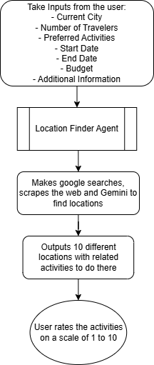
Phase 1
User input: Current City, Budget, Number of Travelers, Dates and the Activities
Output: 10 different destinations and the user can rate each of them on a scale
of 1 to 10

Slide 9
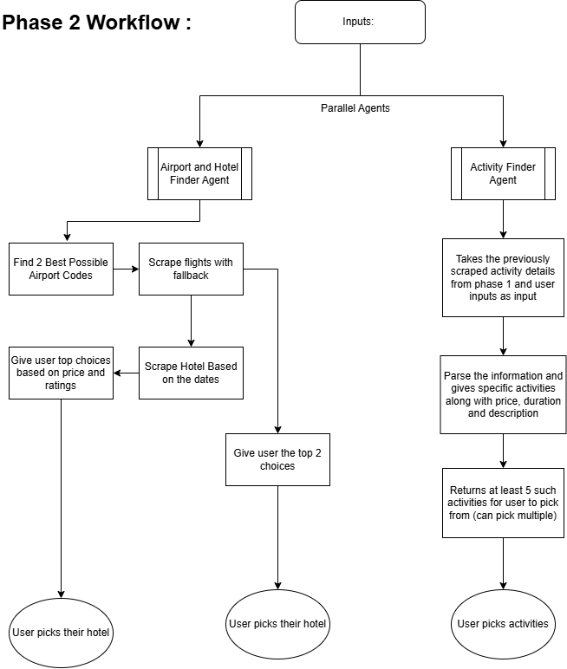
Phase 2
Inputs:
Initial user Inputs
Information scrapped about destinations
Generate:
Airport + hotel finder agent
Activity finder agent

Slide 10
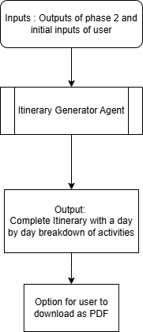
Phase 3
Input: user inputs, Flights, Hotel, activity choices
Output: Clean, complete, robust itinerary

Slide 11

Implementation
Why ADK over other frameworks:
Modular architecture allows independent agent development
Python-first framework (matches your team's expertise)
Native Gemini integration with latest models
Production-ready deployment options
Google ADK
LLM Agent for reasoning and dynamic decision making
Multi agent system architecture

Slide 12
Recorded Demo and Results
03

Slide 13
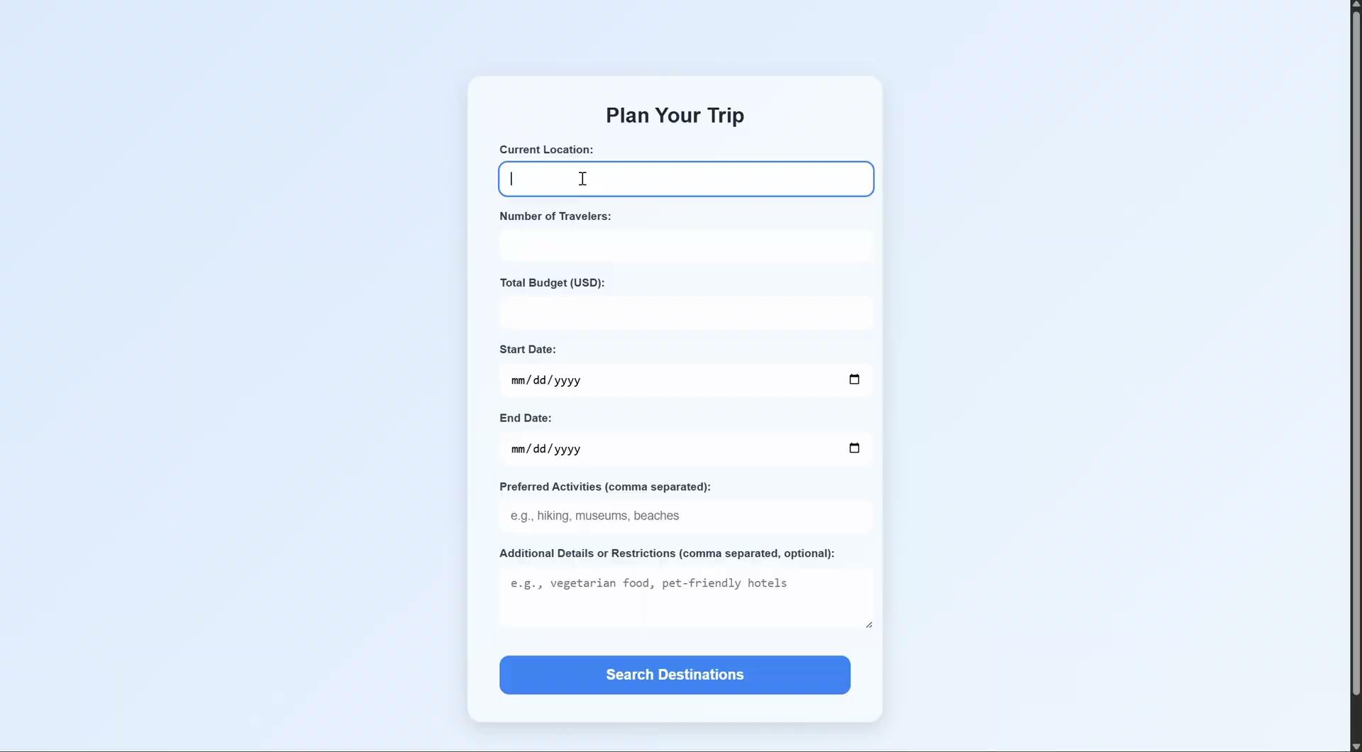

Slide 14
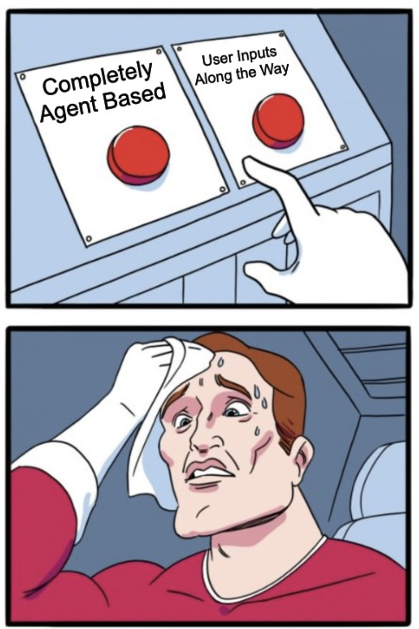
Problems and Dilemmas
How much User Involvement and What kind of Flow?

Slide 15
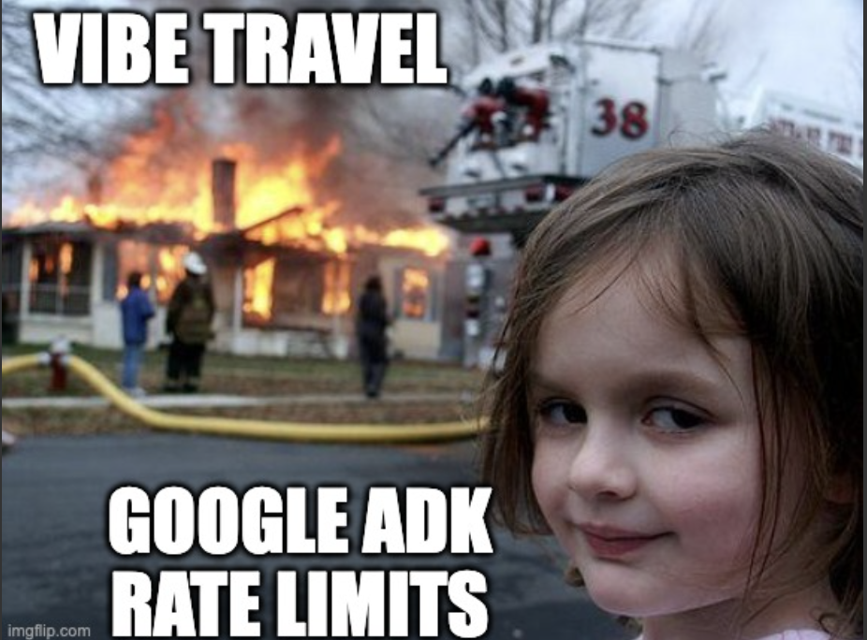
RATE LIMITS AND ERRORS !!!!!!!!!!!!!

Slide 16
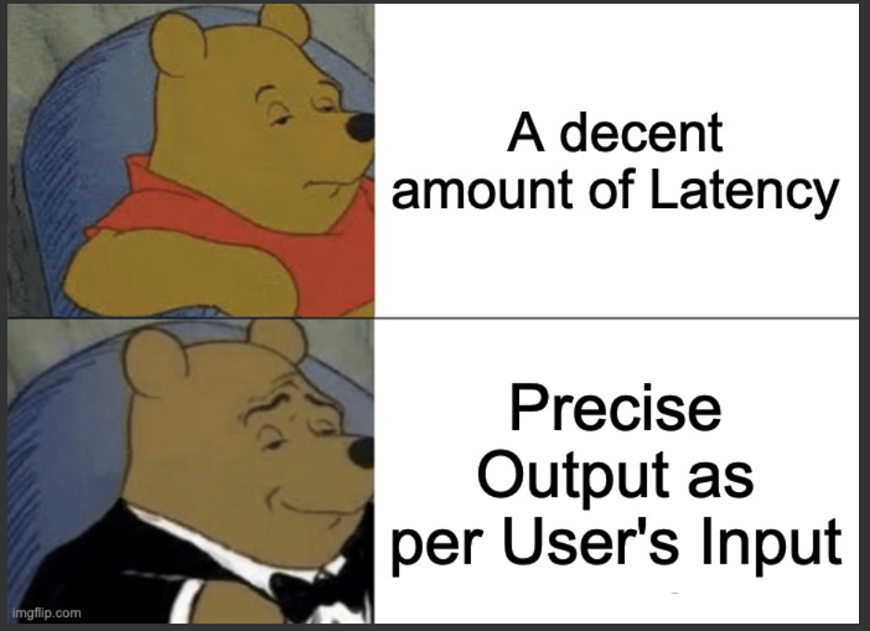
LATENCY

Slide 17
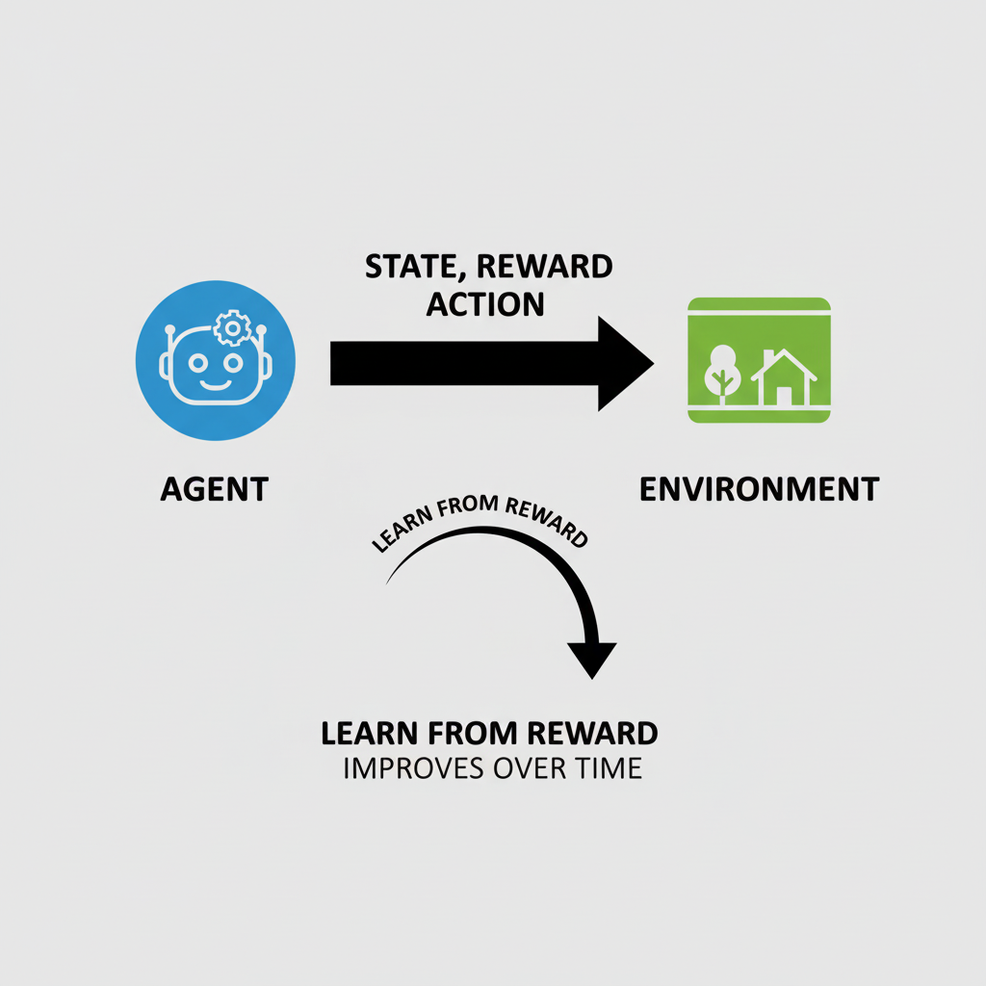
Future works
Reinforcement Learning from Human Feedback
Latency reduction

Slide 18
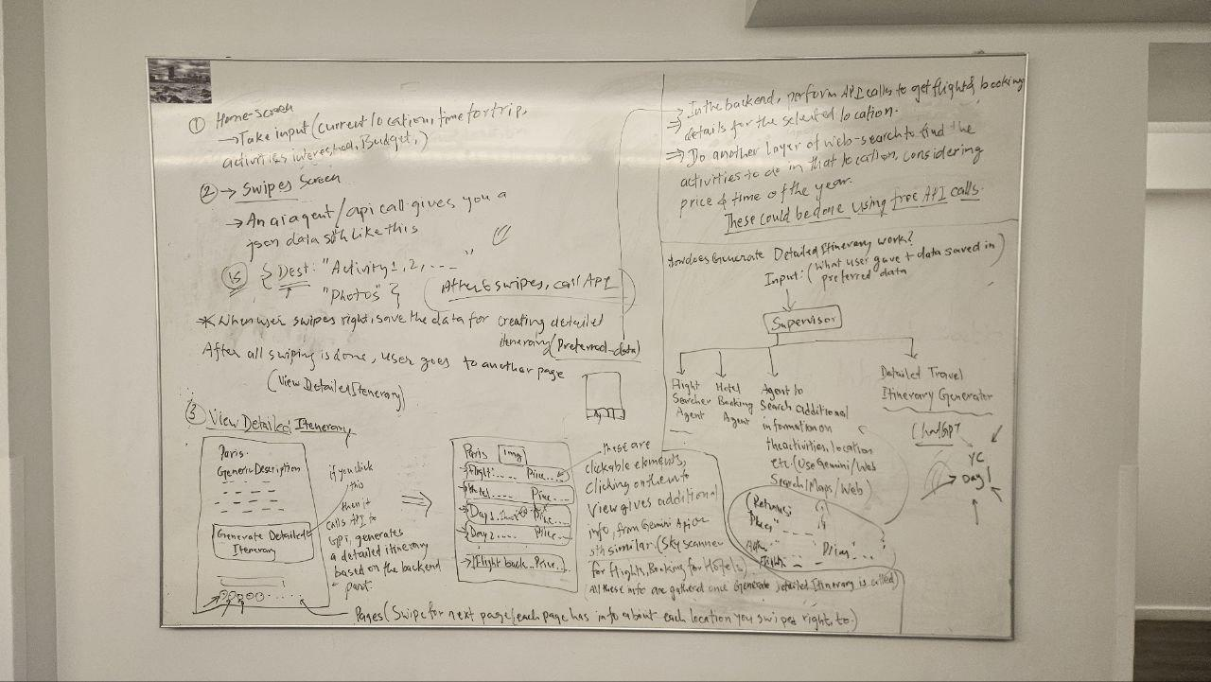
Background work

Slide 19
Conclusion
Review: Harder than expected, with more issues in the architecture
Team work: Successful assignment of responsibilities
Product: Full Stack AI travel Agency specialized in satisfying users desired vacations based on interests and activities

Slide 20
Citations
TravelPlanner: A Benchmark for Real-World Planning with Language Agents. Jian Xie, Kai Zhang, Jiangjie Chen, Tinghui Zhu, Renze Lou, Yuandong Tian, Yanghua Xiao, Yu Su. arXiv:2402.01622, 2024.arxiv​
TravelAgent: An AI Assistant for Personalized Travel Planning. Aili Chen, Xuyang Ge, Ziquan Fu, Yanghua Xiao, Jiangjie Chen. arXiv:2409.08069, 2024.arxiv​
Google ADK : https://google.github.io/adk-docs/

Slide 21
THANK YOU

